Slide 1
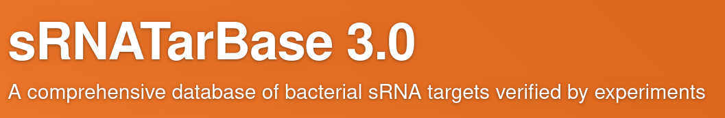
Knowledge Graph displaying Bacterial sRNA
Presentation in Linked Open Data and Knowledge Graphs WS 22/23
09.01.2023
Page <number>

Slide 2
Overview
Bacterial sRNA
Datasource
Datastructure I - II
Nodes, Edges and Relationships
Creating a Knowledge Graph
Queries
Query Problems
09.01.2023
<number>

Slide 3
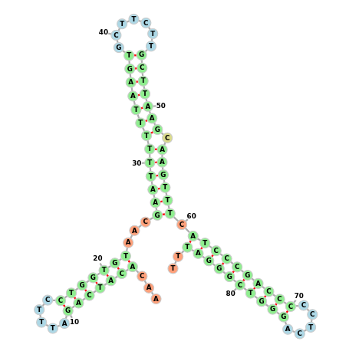
Bacterial sRNA
Small non encoding RNA
Sequences of ~ 50 – 500 nukleotides
Regulate the activity of genes
Genregulation determines if target is built or not.
Important to keep the organism resilient to
external factors like heatstress, osmolarity, ...
AACACATCAGATTTCCTGGTGTAACGAATTTTTTAA
GTGCTTCTTGCTTAAGCAAGTTTC
ATCCCGACCCCCTCAGGGTCGGGATTT
[1]
SRNA: dsrA
Lenght: 87
Strain: Escherichia coli K 12 MG1655
Target: hns
09.01.2023
<number>

Slide 4
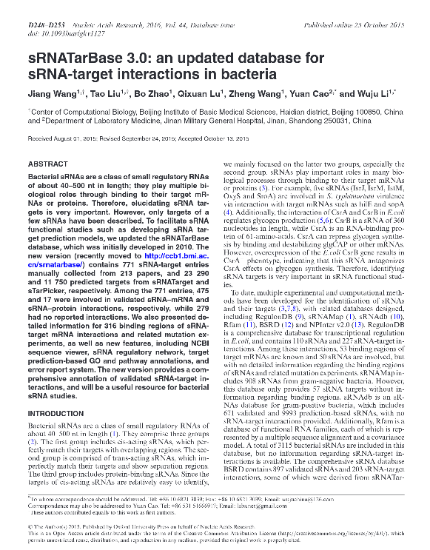
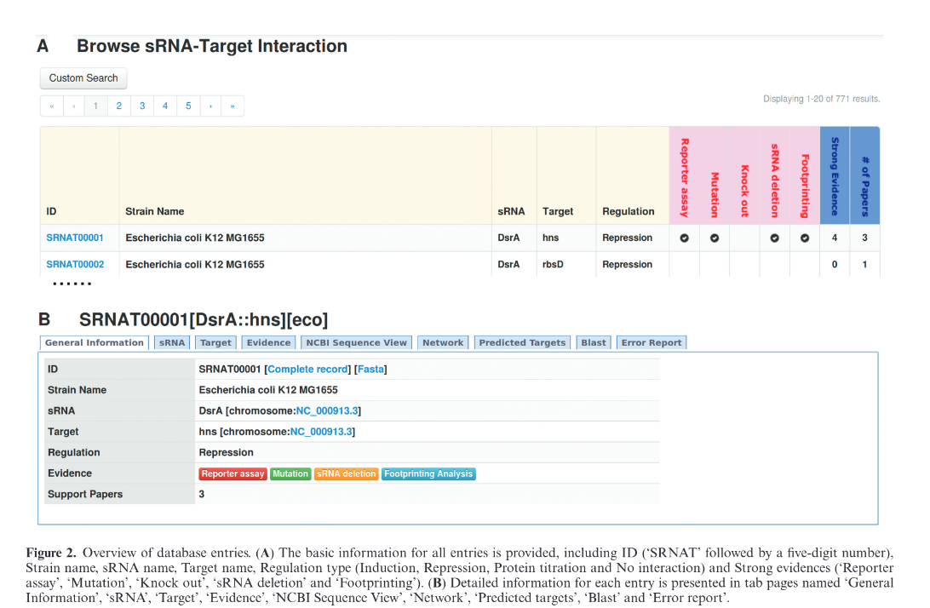
Data Source sRNATarBase 3.0 – Wang et al. - Published 2015
[2]
09.01.2023
<number>
Notes:
SPARQL (pronounced “sparkle”) is an RDF query language for the Semantic Web and first appeared in 2008.
SPARQL is developed by the World Wide Web Consortium (W3C) and along with RDF and OWL, it is one of the three core technologies of the Semantic Web.
The syntax here is relatively easy to learn, similar to SQL, and is reminiscent of English sentence structure. Like this example: "Return me all items that contain house cats.“
SPARQL is used to represent information from data stored as RDF format. The results from the queries can then in turn be visualized in different ways. For example, as in the Wikidata Query Service as a table, timeline or map.

Slide 5
Data Structure I
SRNA_NAME = Name of sRNA
TARGET_NAME = Name of Target
TAXID = Taxonomic ID
ORG_CODE = Organism Code of the Bacteria
STRAIN_NAME = Name of Strain
SRNA_TYPE = NA, trans-encoded, cis-encoded
SRNA_LENGTH = Lenght of sRNA (Amount of Nucleotides)
SRNA_START = Startpoint
SRNA_END = Endpoint
SRNA_STRAND = forward - reverse (sRNA-Strain)
TARGET_TYPE = Type of the Target (mRNA or Protein)
TARGET_LENGTH = Length of the Target
TARGET_START = Startpoint
TARGET_END = Endpoint
TARGET_STRAND = forward - reverse
REGULATION = inductiv - repressiv > How Target is regulated
09.01.2023
<number>

Slide 6
Data Structure II
SRNA_NAME = Name of sRNA
TARGET_NAME = Name of Target
TAXID = Taxonomic ID
ORG_CODE = Organism Code of the Bacteria
STRAIN_NAME = Name of Strain
SRNA_TYPE = NA, trans-encoded, cis-encoded
SRNA_LENGTH = Lenght of sRNA (Amount of Nucleotides)
SRNA_START = Startpoint
SRNA_END = Endpoint
SRNA_STRAND = forward - reverse (sRNA-Strain)
TARGET_TYPE = Type of the Target (mRNA or Protein)
TARGET_LENGTH = Length of the Target
TARGET_START = Startpoint
TARGET_END = Endpoint
TARGET_STRAND = forward - reverse
REGULATION = inductiv - repressiv > How Target is regulated
09.01.2023
<number>

Slide 7
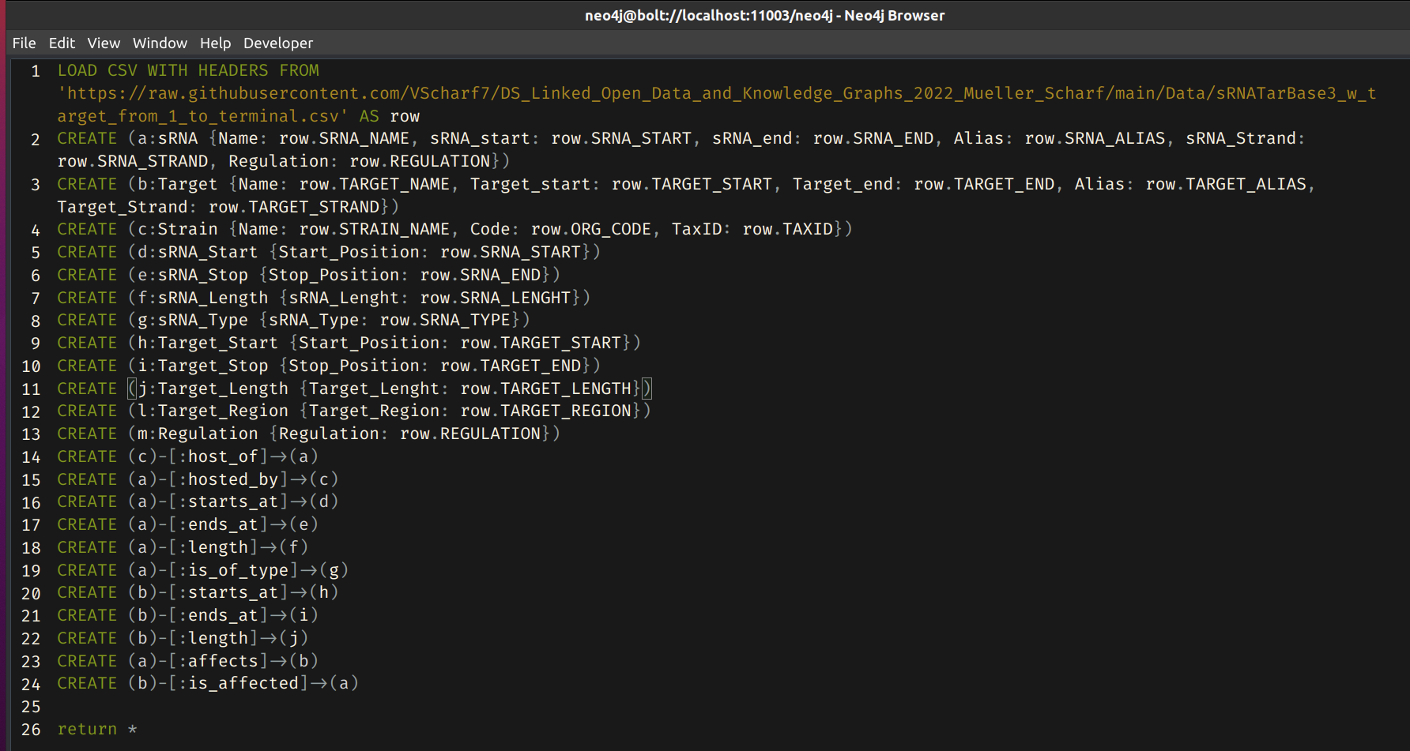
Nodes, Edges and Relationships
09.01.2023
<number>

Slide 8

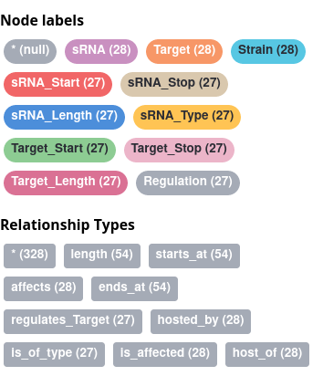
Building of Knowledge Graph
09.01.2023
<number>

Slide 9
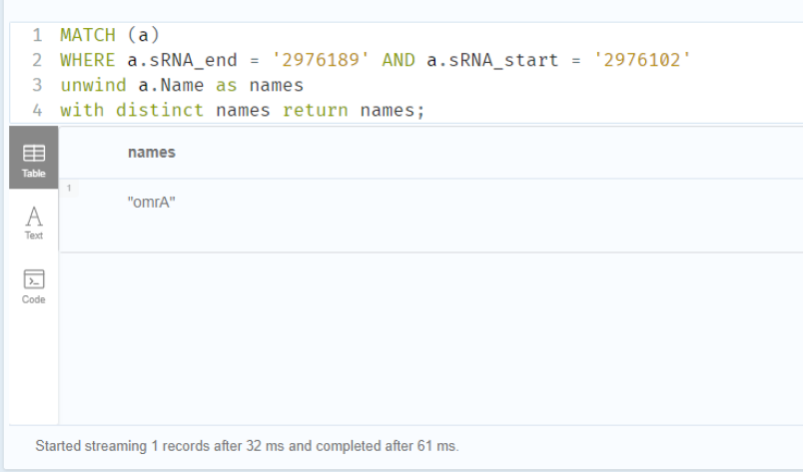
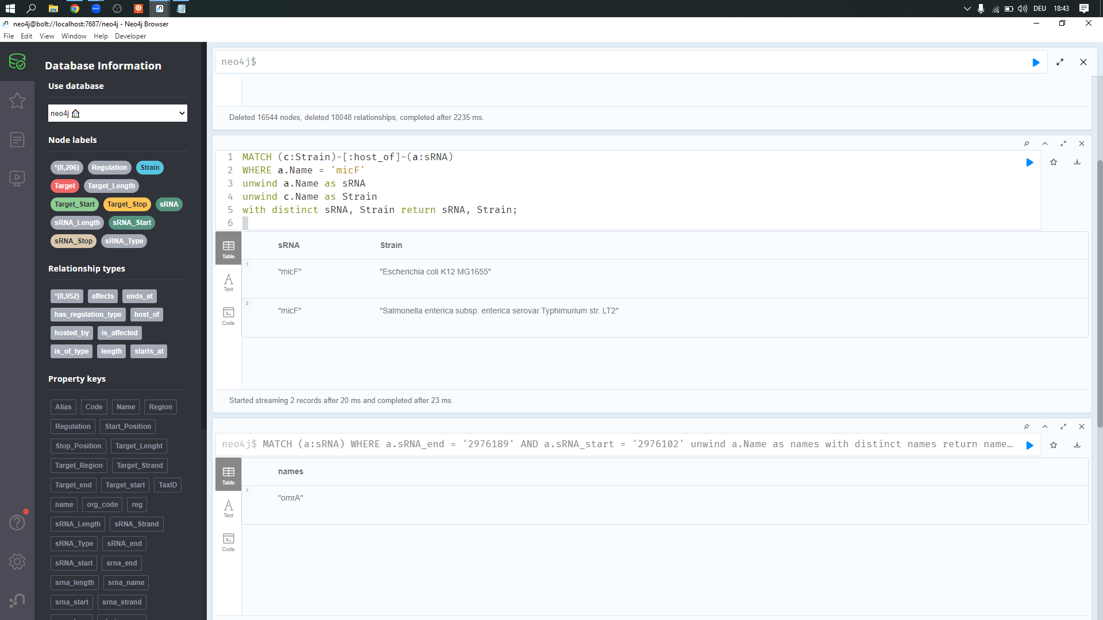
Queries
09.01.2023
<number>

Slide 10
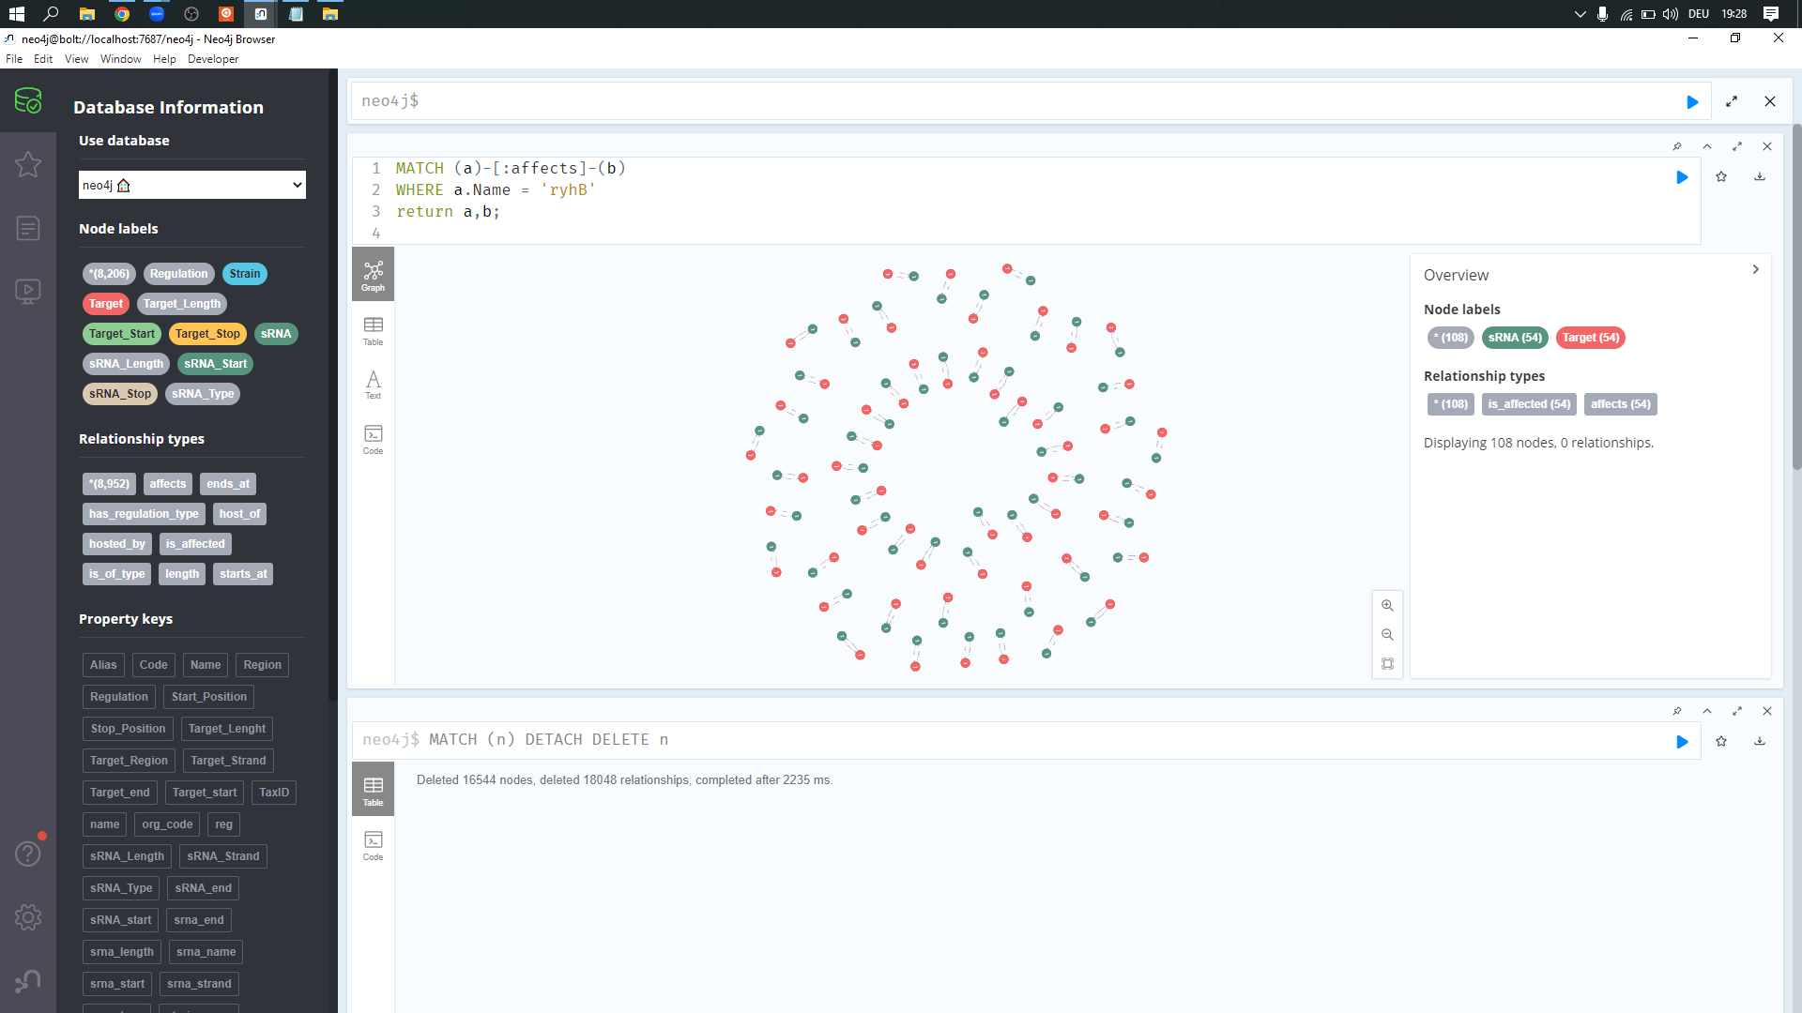
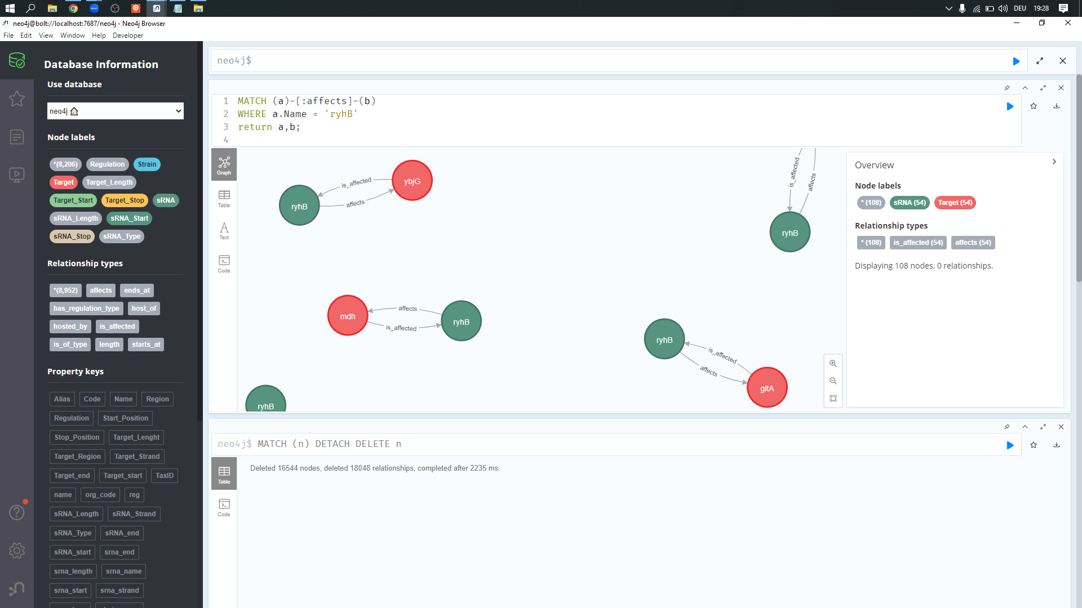
Queries
09.01.2023
<number>

Slide 11
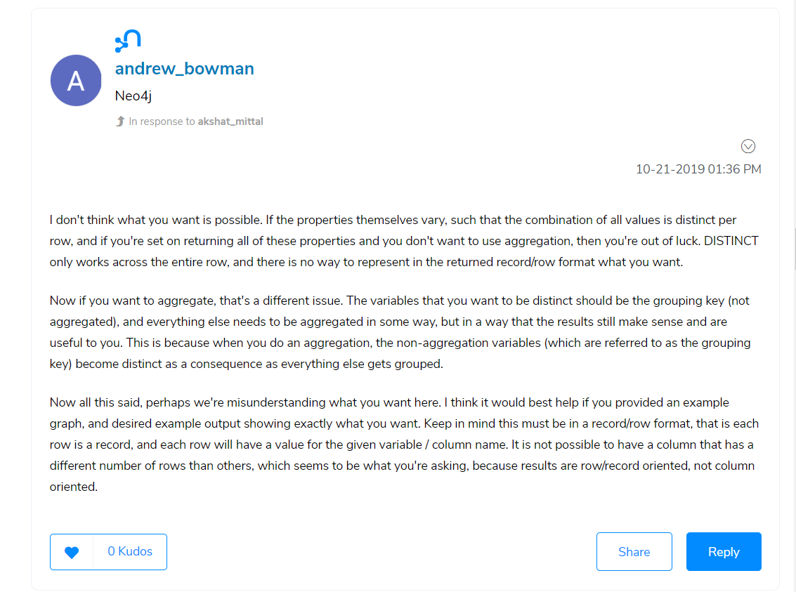
Query Problems
[3]
09.01.2023
<number>

Slide 12
References
[1] http://ccb1.bmi.ac.cn:81/srnatarbase/index.php?r=srnaTarget/view&id=1
[2] Nucleic Acids Research, 2016, Vol. 44, Database issue - doi: 10.1093/nar/gkv1127
[3] https://community.neo4j.com/t5/neo4j-graph-platform/the-traversal-framework-in-v4/m-p/32063
[4] https://doi.org/10.1016/bs.adgen.2015.05.001 sRNA in Bacteria
Thank you for listening
09.01.2023
<number>

